Slide 1
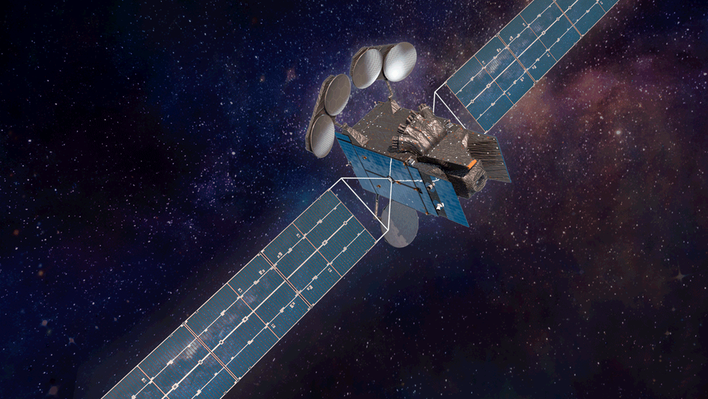



Middle East & Africa Space-based Monitoring of Atmospheric-pollution (MEASMA) Observatory: Proposed Mission
Raid M Suleiman, Xiong Liu, Kelly Chance, Omar Emam, and Sheldon Drobot
TEMPO/GEMS Joint Science Team Workshop
August 26-30, 2024

Slide 2
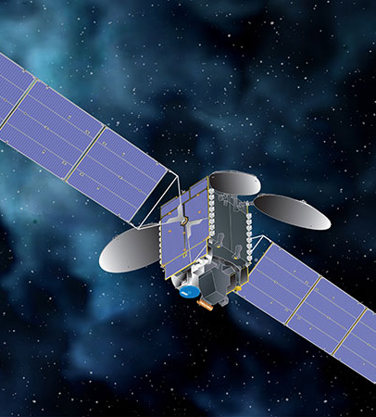

The Beginning …
Invited talk: The 11th Arab Conference on Astronomy and Space, University of Sharjah, UAE, December 8, 2014.
Talk: Frontiers in Theoretical and Applied Physics, American University of Sharjah (AUS), UAE. February 22, 2017
R M Suleiman, C. Chance, X. Liu 2017 J. Phys.: Conf. Ser. 869 012085, DOI 10.1088/1742-6596/869/1/012085.

Slide 3
there was light
Suleiman RM, Chance K, Liu X. A Geostationary Atmospheric Monitor for Middle East. Arabian Journal of Scientific Research 2021:2.7.
https://doi.org/10.5339/ajsr.2021.7
مقترح لتطبيق مرصد تلوث الانبعاثات التروبوسفيرية
التابع لوكالة ناسا: حمولة مستضافة لرصد الغلاف الجوي من
مدار ثابت بالنسبة إلى الأرض
رائد محمد سليمان، كلي تشانس وشونج لو

Slide 4
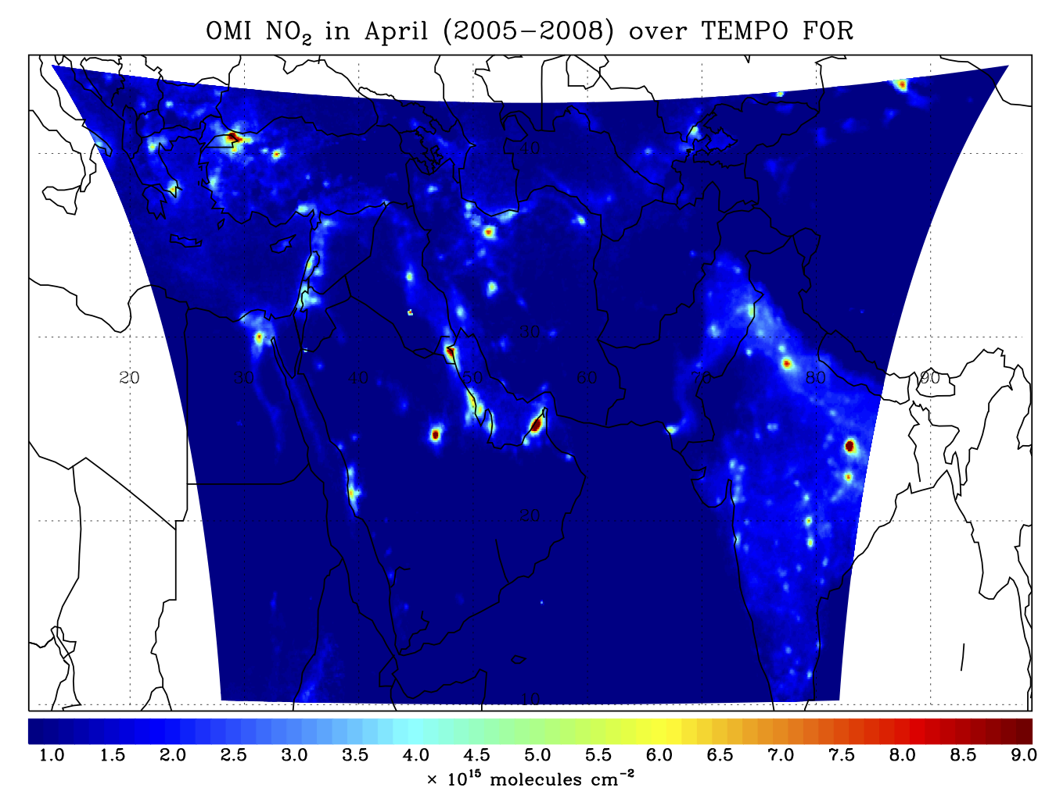
The 1st Proposal
Location | N/S (km) | E/W (km) | GSA (km²)
25ºN, 55ºE | 4.52 | 1.74 | 7.87
Mecca | 4.52 | 1.75 | 7.91
Sharjah | 4.77 | 1.69 | 7.87
Riyadh | 4.60 | 1.74 | 10.2
Jerusalem | 5.05 | 1.99 | 9.73
Cairo | 5.26 | 1.97 | 9.90
Istanbul | 5.57 | 2.52 | 12.77
New Delhi | 5.15 | 1.91 | 9.48

Slide 5
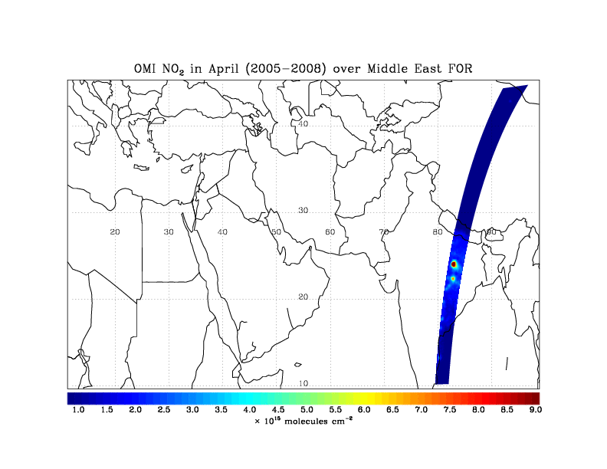

Slide 6
The Current Proposal
MEASMA-GEON (Raid Suleiman, Omar Emam et. al)
MEASMA_GEOS (Pieternel Levelt et. al)

Slide 7
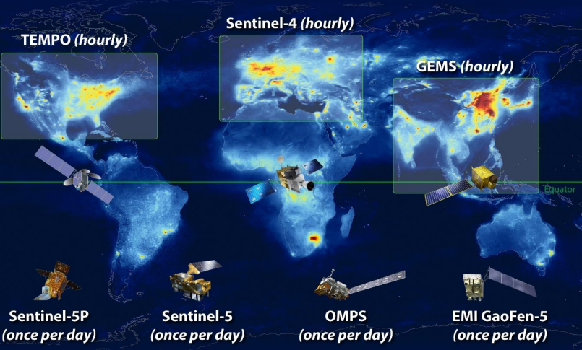
MEASMA-GEO Observatory Instrument Filling the Gap in Global Atmospheric Prolusion Monitoring
MEASMA-GEON (Raid Suleiman, Omar Emam et. al)
MEASMA_GEOS (Pieternel Levelt et. al)
MEASMA-GEON
MEASMA-GEOS

Slide 8
Past & Current Activities (SAO)
2014: Initial concept presented in Sharjah, UAE (in person).
2016: Cadi Ayyad University, Marrakesh, Morocco (in person).
2017: Al Akhawayn University, Ifran, Morocco (in person).
2018: American University of Beirut, Beirut, Lebanon (in person).
2019: National Research Institute of Astronomy and Geophysics (NRIAG), Cairo, Egypt (in person).
2020: King Abdulaziz University, Jeddah, Saudi Arabia (virtual).
2020: ASTROCON 2020, Qatar University, Qatar (virtual)

Slide 9
Past & Current Activities (SAO)
2022: Palestine Academy for Science and Technology, Palestine (virtual).
2023: Palestine Ministry of Education, Palestine (virtual).
2024: Al Akhawayn University, Ifran, Morocco (virtual).
2024: TEMPO-GEMS Science Team Meeting, Hawaii, US.

Slide 10
Past & Current Activities (INFOSPASS)
2023: (Oct. 25) CEOS AC-AV conference, Brussels, Belgium (in person).
2024: (Mar 4) The First International Conference on Sand and Dust Storms, Riyadh, Saudi Arabia (in person).
2024: (May 1) Bridging Horizons: Exploring Space Cooperation Between the UK and the Gulf, organized by SpaceTech in Gulf. (virtual Webinar).
2024: (Jul. 2) 2nd International SPACE UNGANA, Ghana (virtual).
2024: (Jun. 9) Space Enterprise Workshop, Muscat, Oman (in person).

Slide 11
Current Support & Interest
Environmental agency Abu Dhabi (EAD)
SERCO - Saudi as potential partner for data centre.
RAL-Space UK interest to support MEASMA-GEO by contributing to MEASMA-LEO and relates data fusion.
BAE Systems USA
UCSR USA
NASA
CEOS AC-AV
Saudi national centre for meteorology (NCM)
Saudi regional SDS WMO office.
Saudi Space Agency
Oman environmental and air quality agency.

Slide 12
Thank you for your attention!

